Slide 1
Vapes and electricals recycling: for festivals and events teams
June 2024

Slide 2
3 key take-aways
Vape sellers
Vape sellers on site have a legal responsibility to take back customers’ old vapes for recycling and to tell their customers that they offer this.
Waste contractors
Waste contractors must ensure that all waste batteries and electricals left on site (including vapes) are disposed of responsibly using a registered AATF scheme
Festival-goers
The festival audience needs to know that they should never bin their vapes or electricals, they must always recycle them.

Slide 3
Update: British Metals Recycling Association (BMRA) call on music festivals to impose an outright ban on all disposable vapes.
16th May 2024
If you choose this year to ban disposable devices at your event, it is still important to consider how vapes which make their way on site will be handled.
Likewise, despite the forthcoming national ban on the sale and supply of disposable vapes, the issue of e-waste on site will not immediately disappear as ‘pod devices’ become more popular and disposable vapes continue to remain available during the phase out period.
FastTech like power banks, cables, and headphones should also be considered as a waste issue and will need to be handled appropriately

Slide 4
Contents
Who are Material Focus?
What is e-waste and why is it relevant to festivals?
Vape facts and figures
How do I encourage good practice as a festival organiser?
How can i set up vape/e-waste bins on site?
Bin supplier information
Bin signage
Funding
How can waste contractors ensure e-waste is processed correctly?
Approved vape recycling services
How can onsite vape retailers comply with environmental legislation?
Take-back communications
How can i increase audience awareness of e-waste issues?
Recycling locator
Communications toolkit
Audience data
Partner with us

Slide 5
Who are Material Focus?
We are an independent, not-for-profit organisation on a mission to get the UK fixing, donating and recycling all of their old and unwanted electricals. And stop precious resources from being lost forever. We do this through…
Insights
Identifying, producing and sharing insightful, timely and impactful research to help build a better UK e-waste/ WEEE system.
Investments
Identifying and funding projects which help make it easier for people to reuse and recycle electricals.
Inspiration
Creating and delivering communications which help make it feel easier for people to reuse and recycle electricals through our Recycle Your Electricals campaign.

Slide 6
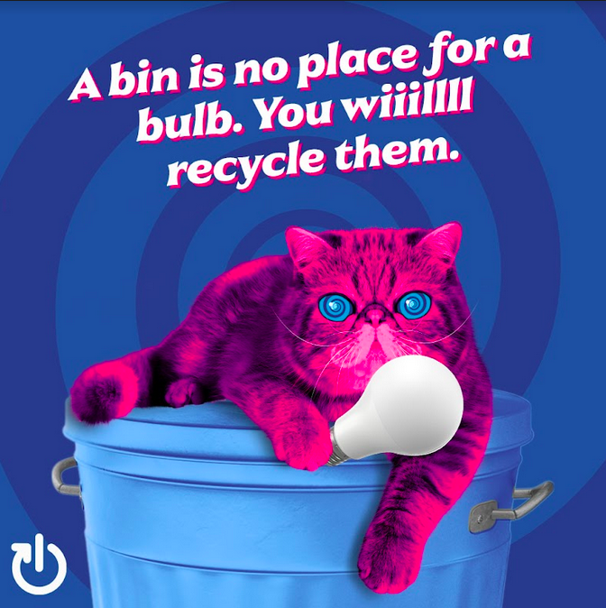
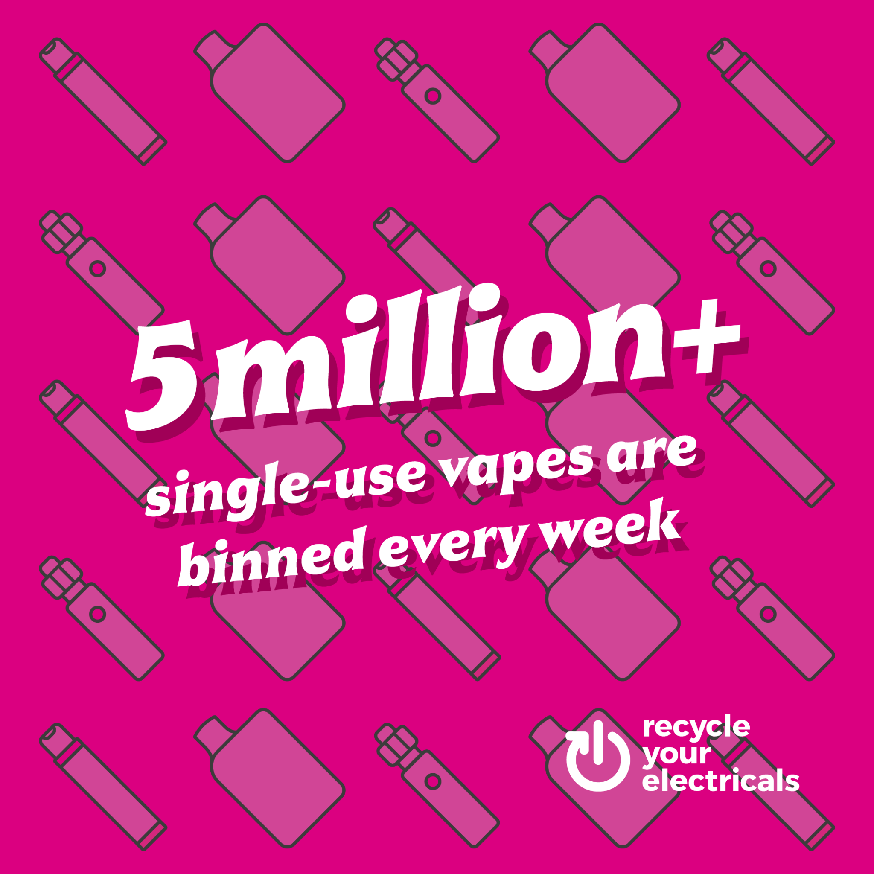
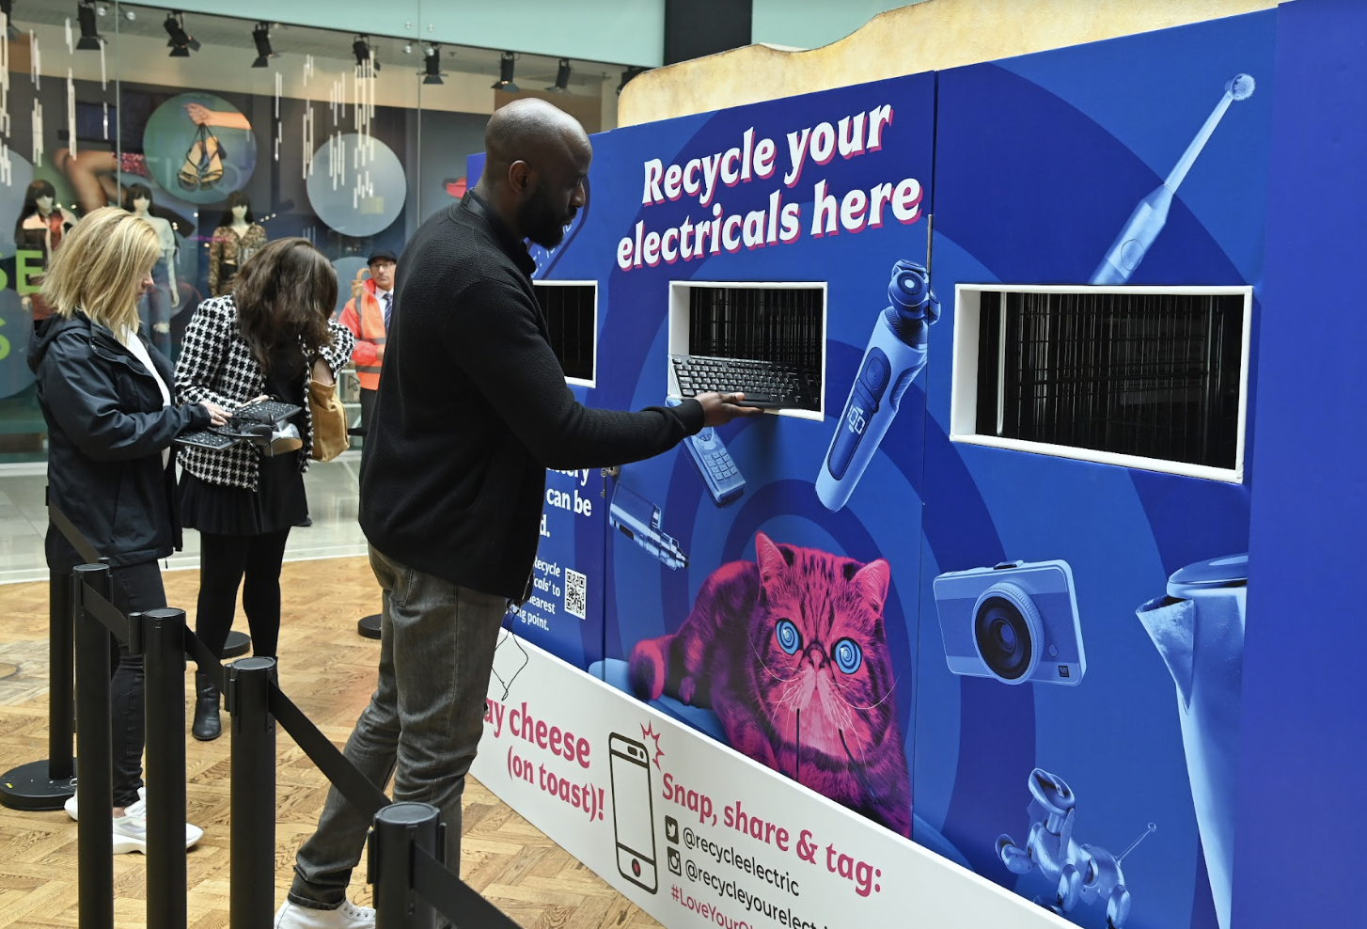
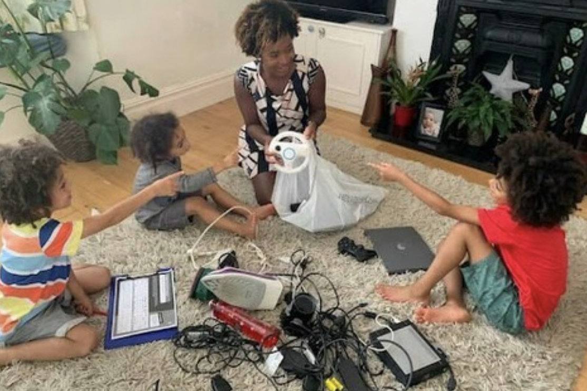
Inspiration
Earth Hour
Battery fires
Key moments
Awareness
Give Back January
Giant toaster bring bank
Waste Week schools campaign
Education

Slide 7
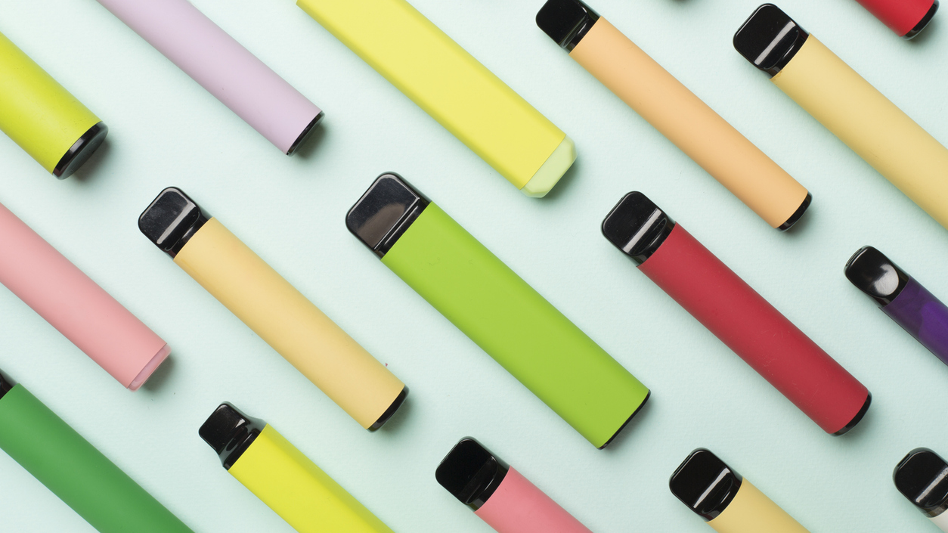
What is e-waste and why is it relevant to festivals and events?

Slide 8
What is e-waste and what are the legal regulations?
e-waste (WEEE) is old and unwanted electrical and electronic equipment
Most e-waste contains toxic chemicals and is classed as hazardous waste
If not handled properly at end-of-life they pose a major threat to the environment, human health, society, and costs the UK economy through losing precious resources
Recovering materials like steel, aluminium, copper, gold, silver, lithium and plastics means that we reduce demand for new materials that come from mining and drilling and therefore protects land and sea environments.
e-waste is one of the fastest-growing sources of waste in the world – and the UK.
103,000 tonnes of e-waste are thrown away each year by households
We are holding on to 880 million unused items of electricals in UK homes.
Laws requiring producers and retailers to finance and support collection and recycling of electrical and portable battery products at end-of-life have been in place for 15 years.
Anything with a plug, battery and cable should always be recycled as a minimum and should never be binned.
Notes:
Scott - Governance

Slide 9
Vapes and e-waste at festivals and events
As disposable vapes and FastTech (cheap throwaway electricals) continue to increase in popularity amongst festival goers, they present environmental and health and safety risks for festival organisers, and a new challenge for ops teams and waste contractors:
Increased fire and health and safety risk for staff and festival goers
Increased contamination of compost and recycling waste streams
Waste management challenges as electricals require hazardous waste processing methods and increased costs for event organisers having to provide these services
Environmental pollution as littered vapes and electricals may remain within the natural environment post clean up, causing potential damage to wildlife and festival sustainability credentials
Resource waste of some of the most valuable resources on the planet - steel, aluminium, copper, lithium

Slide 10
Why are discarded vapes such an issue?
Vapes = dangerous waste - Safety issues with the lithium batteries inside them prone to causing fires if damaged when binned in general waste or recycling.
Sales have rocketed - Many new products and market entrants over the past few years
Range of vape types - single use (disposable), rechargeable with single use chamber (pod) and rechargeable (tank).
Single use vapes are marketed as disposable, not recyclable - Very little communications on options for recycling them being presented to the public.
An average of 7.7 million single-use vapes are being sold every week in the UK - At least 5 million a week are being binned which is 8 per second.
Producers, importers, distributors and retailers of single-use vapes need to do more - In order to meet their legal and financial responsibilities under UK waste electrical (WEEE) and portable battery regulations.
Source: Material Focus research

Slide 11
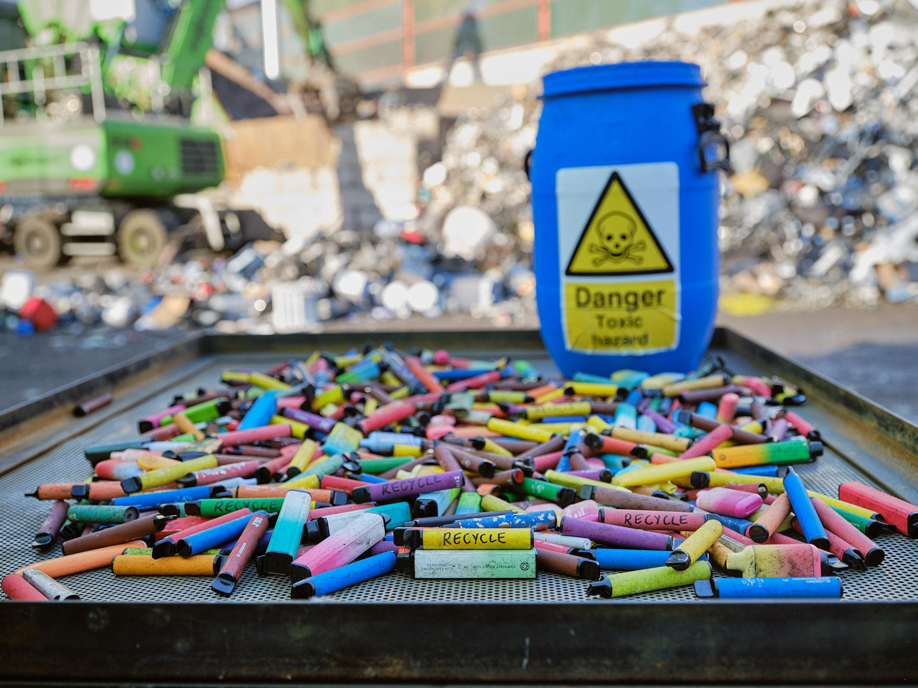
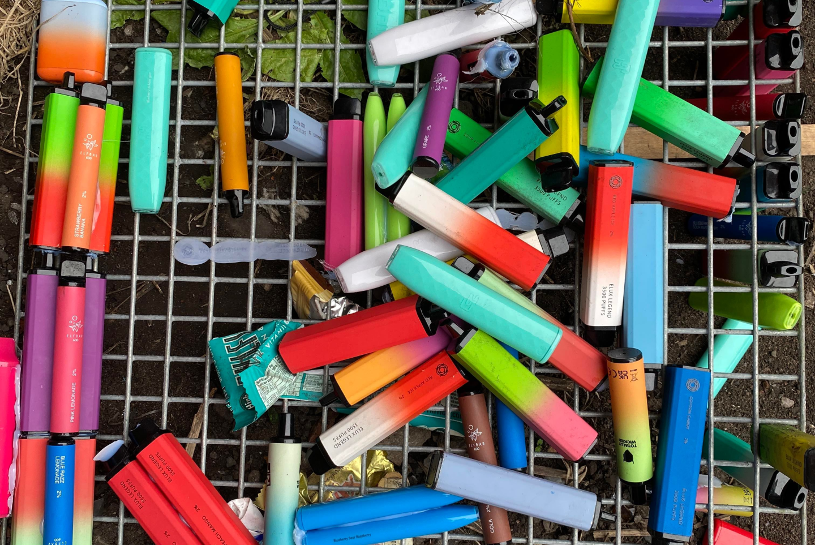

Slide 12
Vapes facts and figures
We are throwing away millions of vapes
In the UK we are buying 7.7 million single-use vapes per week, (doubled compared to 2022).
In the UK we are binning 5 million single-use vapes per week, that is 8 per second (quadrupled compared to 2022).
Single-use ‘disposable’ vapes are actually recyclable
The vapes will be dismantled into parts: battery, casing electronics and nicotine pads which are then treated separately. Up to 80% of materials within vapes can be recycled.
There’s hidden treasure inside vapes
Vape batteries contain lithium (vital component inside electric vehicle (EV) and energy storage batteries), aluminium, steel, copper, plastics which could be recycled, saving precious resources from being lost forever.
5,000 electric vehicle batteries worth of lithium being thrown away per year
Source: Material Focus research
Notes:
https://www.materialfocus.org.uk/wp-admin/post.php?post=21756&action=edit

Slide 13
Vapes facts and figures
The lithium inside vapes that are thrown away could be powering the green economy
Our research has found that 5,000 electric vehicle batteries worth of lithium being thrown away per year
Hidden batteries inside can cause fires if crushed or damaged
Batteries hidden inside vapes can cause fires if crushed or damaged in general recycling or waste streams. Vapes must be recycled separately.
Adding to the problem of e-waste
Binning vapes adds to e-waste which is the fastest growing waste stream in the world. In the UK alone we bin over 155,000 tonnes of electrical waste a year.
Source: Material Focus research

Slide 14
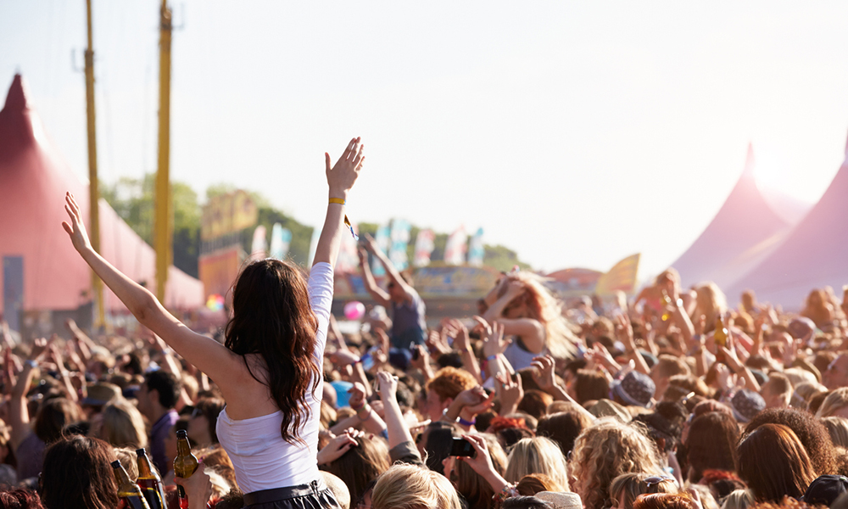
How can I encourage good practice as a festival/event organiser?

Slide 15
What can you do?
Establish a recycling system for vapes and electricals:
Establish separate recycling bins for vapes and e-waste with clear signage. Reduce littering and waste stream contamination by making it clear to your audience where vapes need to go.
Consider using different shaped bins for vapes and e-waste to reduce contamination.
Ensure litter pickers separate vapes and e-waste from other waste streams.
Ensure your messaging and communications align with what festival goers can expect to see onsite, so that vape bins are instantly recognisable.
Open a conversation with your waste contractor to discuss how e-waste is processed back of house - Ensure they will work with a recommended AATF provider to handle e-waste.

Slide 16
What can you do?
Communicate with your retailers
Ensure all on site vape sellers are aware of their legal obligation to offer take back
Ensure retailers selling FastTech like electric fans, power banks, air bed pumps, are aware of where to sign post users with broken goods
Communicate with your audience
Use volunteer crews to interact with and educate your audience
Check out our suggested audience communications approaches
Communicate with your artists
Offer artists reusable vapes instead of disposables if requested on riders
Encourage artists to spread the message to their audience
Gather feedback
Collect data using post event audience surveys
Analyse data to learn what could be done better

Slide 17
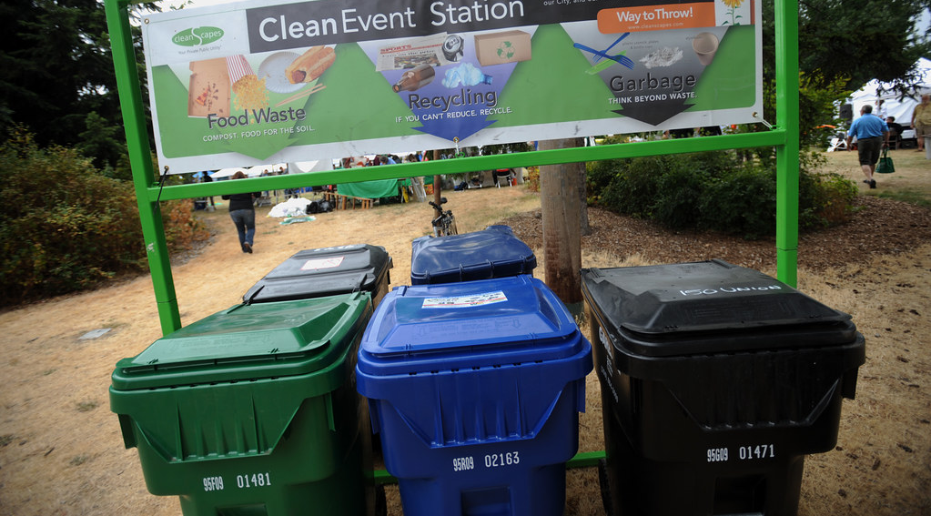
How can I set up vape/e-waste bins on site?

Slide 18
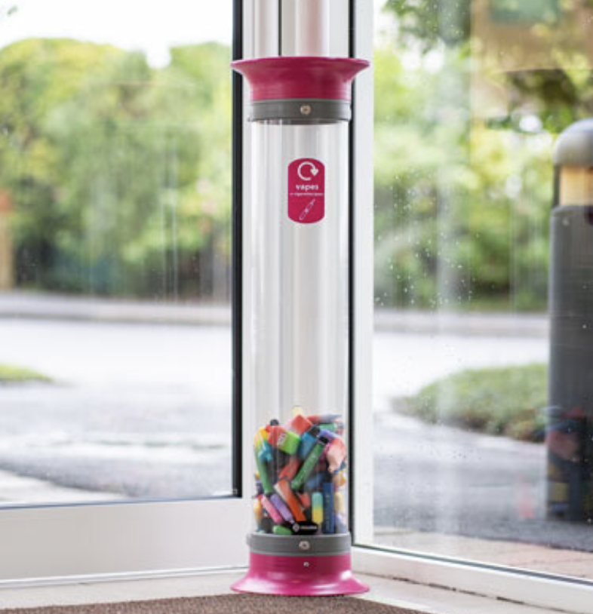
Bin model options
Box cycle recycling bin
C-Thru™ 15L Vape Recycling Bin

Slide 19
Bin supplier information
These are the suppliers we are already aware of:
Soho Commercial - 240 litres and 1100 litres
https://uk.glasdon.com/ - Nexus style bins
https://www.kingfisherdirect.co.uk/box-cycle-recycling-bin - Box cycle bins
https://totebox.co.uk/product/54l-tote-box-600-x-400-x-320h-mm-2/ - Tote boxes
https://uk.glasdon.com/c-thru-15-vape-recycling-bin - Vape bins

Slide 20
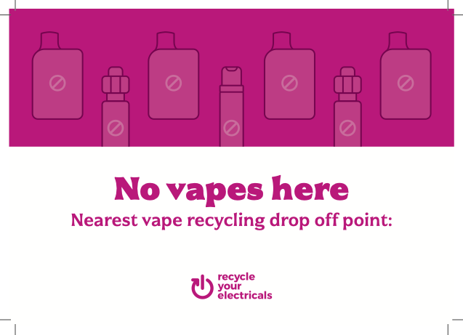
Bin signage
You can find our eye catching vape bin sticker designs within our communications toolkit. These can be personalised with your add your logo (using InDesign templates), ready to print and use.
Our assets are free to download. If you’re not already registered, sign up today - it takes less than 2 minutes!

Slide 21
Funding for vape bins
We have funding available for 3 festivals across the UK to go towards the cost of ordering separate bins for vape collection. We are able to fund up to £500 for each successful festival/production company.
In return, we request that you provide reporting data on the amount of vapes collected, and use our branding to promote electrical recycling.
Funding criteria:
You must demonstrate that all vapes and WEEE collected will be recycled using an approved AATF
Ideally organisers will ensure that bins are used at multiple events throughout the season
If you think your event could benefit from our funding, please get in touch with rowan@materialfocus.org.uk to discuss partnership options
Notes:
Funding process: https://docs.google.com/document/d/1gD57nX56Xngb8TTFffe42BWnLS6ufh46hHYQW3WGVeE/edit?usp=sharing

Slide 22
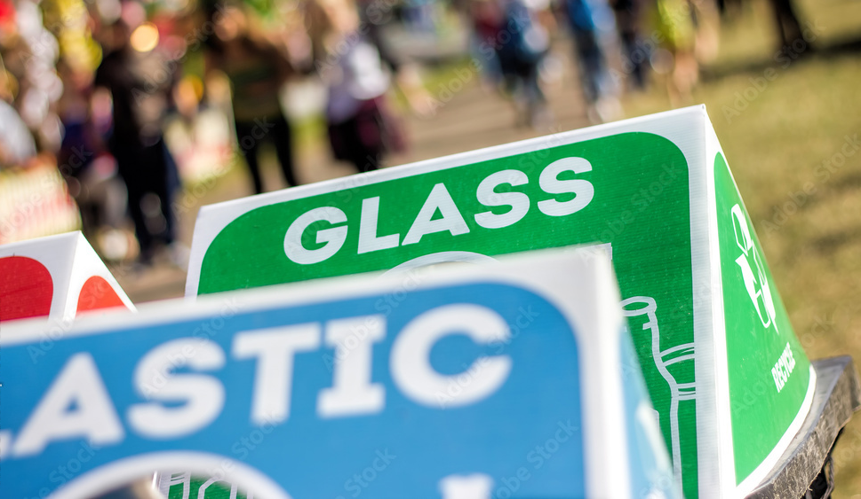
How can waste contractors ensure e-waste is processed correctly?

Slide 23
Waste contractor obligations
Businesses have a legal responsibility and duty of care to ensure waste is stored safely and disposed of appropriately. Regulations require the following actions:
› Pre-treatment (i.e. sorting recyclable and non-recyclable material) is also a duty business must fulfil. This can be onsite or completed by your registered waste collector at a sorting facility.
› Safe onsite storage for all waste.
› Collection by a registered waste carrier.
› Disposal of the waste must take place at a licensed waste disposal facility.
› Waste must be covered by a waste transfer note.
Source: Vision 2025:Festival industry materials and waste briefing

Slide 24
Working with your waste contractor
Festivals need to ensure that their policy and advance messaging prevents or limits non-essential use of hazardous materials, and that they are confident waste materials are being dealt with legally. This means you will need to have weighbridge certificates for the materials removed from site on file to prove safe transfer.
Batteries and e-waste are classed as hazardous waste. This means they must be kept separate by law and and cannot be put in general waste. Work with contractors to ensure you have adequate and safe locations for storage of hazardous materials such as batteries and e-waste.
For handling e-waste, we strongly recommend that your waste contractor works with an approved vape recycling service: Although there may be other charities or waste management companies offering a similar service, there is no guarantee that they will operate safely and environmentally responsibly.
When processed through an approved AATF, vapes will be dismantled into parts: battery, casing electronics and nicotine pads which are then treated separately. Up to 80% of materials within vapes can be recycled.
Source: Vision 2025:Festival industry materials and waste briefing, Material Focus research

Slide 25
Approved vape recycling services
These waste management companies can organise collection and recycling of vapes at Approved Authorised Approved Facilities (AATFs).
Biffa - contact: services@biffa.co.uk
Environcom - contact: Alison.mitchell@environcom.co.uk
GAP Group - contact: waste@gapgroupuk.com
Reconomy - contact: enquiries@reconomy.com
Recover - contact: info@eco-recycle.co.uk
SWEEEP - contact: recycle@sweeep.co.uk
Veolia - contact: https://www.veolia.co.uk/contact-us
Waste Care - contact: recycling@wastecare.co.uk
Waste Experts - contact: info@wasteexperts.co.uk

Slide 26
How can onsite vape sellers comply with environmental regulations?

Slide 27
Seller responsibilities - for all retailers selling electricals
All retailers selling electricals (including vapes) need to provide a way for customers buying new electricals to dispose of their old electricals on a like-for-like basis
They must take back items that have the same function, regardless of brand
Currently there is no distinction between the types of e-cigarettes or vapes that they sell in regards to takeback obligations e.g. stalls selling reusable vapes must take back disposables
All types count the same, therefore if they sell any type of e-cigarette or vape then they are legally required to takeback any type on a like-for-like basis
They have 3 options to offer this take-back service to your customers
provide a free, in store recycling service
set up an alternative recycling service
join the Distributor Takeback Scheme (DTS) - if they sell electricals worth < £100k, or online only
If they fail to comply with the waste electrical and electronic equipment (WEEE) regulations, they can be prosecuted and get an unlimited fine from a magistrates’ court or a Crown Court.
* Source: Electrical waste: retailer and distributor responsibilities: Take back waste in store - GOV.UK
Notes:
The Office for Product Safety and Standards enforces retailer regulations. You can contact them if you have any questions on compliance or suspected non-compliance - OPSS.enquiries@beis.gov.uk
‘Very small WEEE’ are items of waste electrical and electronic equipment that are less than 25cm on their longest side.
You must take back all items of ‘very small WEEE’ in store if your electrical and electronic equipment sales area is greater than 400 square metres including aisle, display and shelf space.
You must provide this service to everyone for free, regardless of whether they’ve bought anything from your store.

Slide 28
Minimum requirement for Retailer Take-back communications
Retailers must accept consumers’ old electricals in store for recycling - and tell customers about this service. We worked with OPSS/Dept for Business and Trade (DBT) to help ensure consistency across all consumer communications. Direct your onsite retailers towards our OPSS/Dept for Business & Trade approved retailer take-back comms toolkit which contains ready-made and editable assets and key messaging to enable retailers to meet their obligations. There are like-for-like, recycle all, and recycle vapes options. Mandatory
Strut cards and posters, Point of sale comms - for use on vape stalls
QR code or web address - directing people to retailer websites or Recycle Your Electricals
Optional
Recycle Your Electricals Recycling Locator link or widget - most comprehensive and accurate locator
‘Proud supporter’/‘recycle here’ - available as window decal or stand-alone logo
Receipt or till prompt
On-packaging options
Staff training support

Slide 29
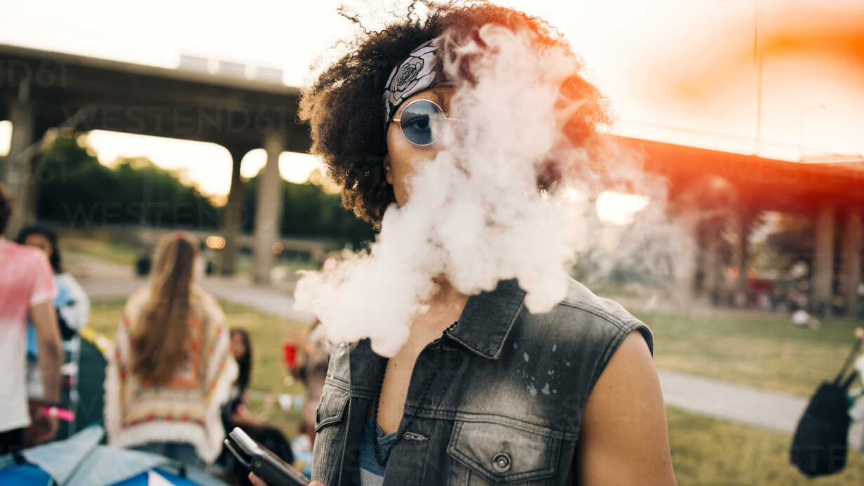
How can I increase festival-goers awareness of e-waste issues?

Slide 30
Communications approaches
Create social media posts and mailers using our festival communications toolkit. It includes ready-to-use social media assets with suggested copy on recycling vapes, batteries and other posts relating to recycling at festivals. Download here.
Increase audience awareness of the bins available onsite using posters, stage side screens, bar signage, and signage on vape stalls
Ensure bins are clearly labeled using our bin stickers (available within the festival communications toolkit)
Make information about vapes and e-waste available at onsite information points
Use festival app to issue alerts and reminders about the recycling facilities available on site
Promote our industry-leading Recycling Locator (22,000+ drop off points) to help your audience easily locate their nearest electrical recycling drop-off points for vapes and other electricals like power banks, headphones, and electric fans

Slide 31
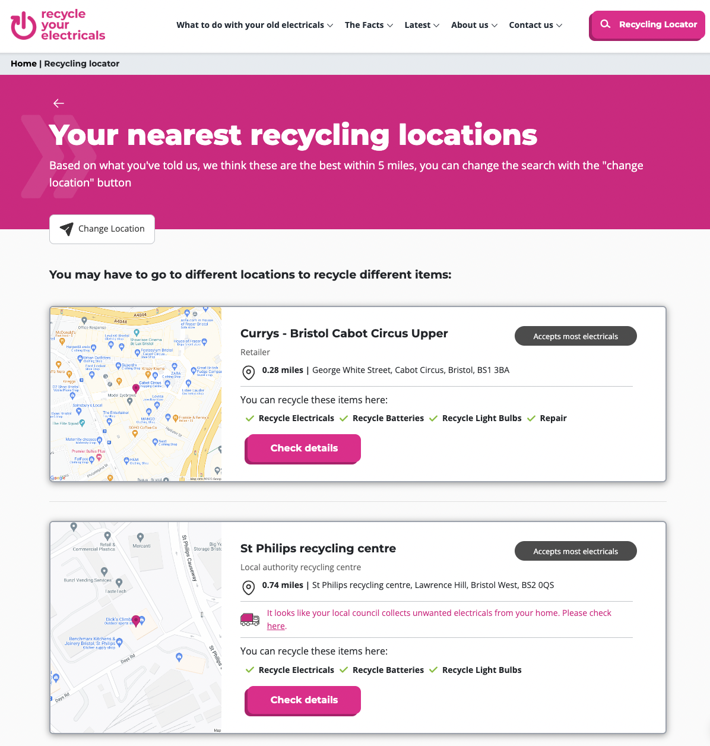
Our Recycling Locator makes it easy to find local drop off points
With over 22,000 drop off points, our best in class Recycling locator provides the most comprehensive collection of electrical recycling points in the UK.
Users can find local drop off points to recycle, donate or fix their unwanted electricals. It’s so simple to use - simply:
Pop in your postcode or address
Select the items and whether you’d like to recycle, donate or fix them
View your nearest drop-off point that accepts your specified items
You can also add our recycling locator widget to your website. Get in touch with us to discuss coding options.

Slide 32
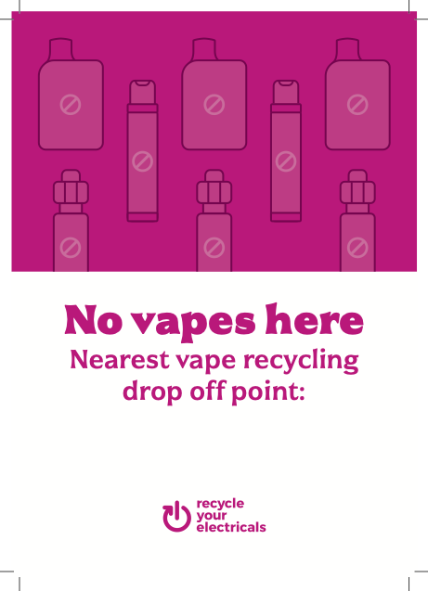
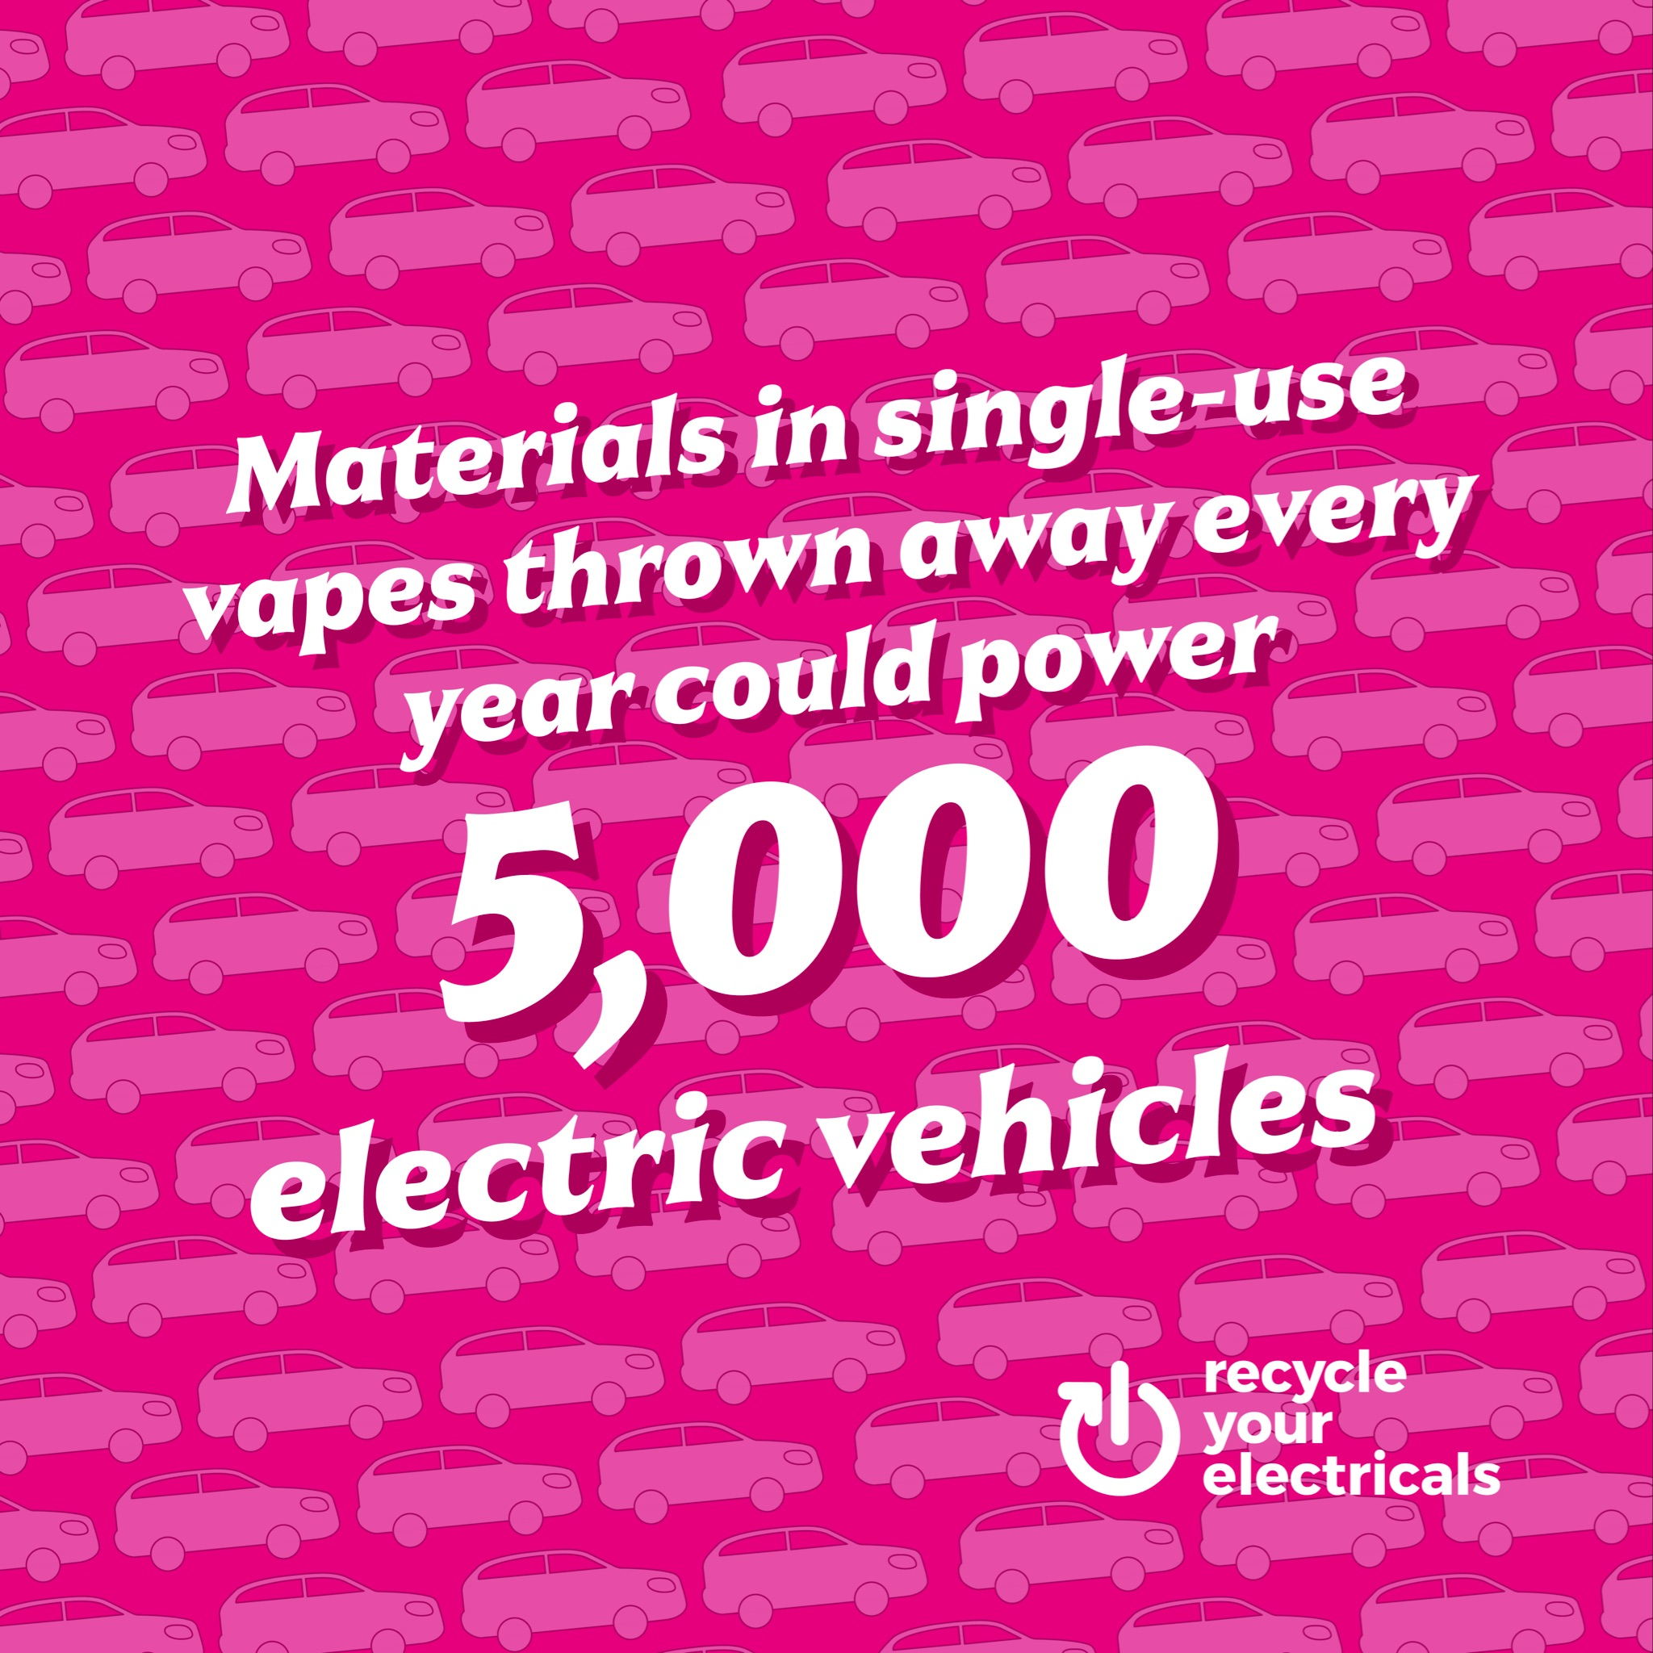
Festivals and events communications toolkit
Download from the partnership portal on our website here. If you would like to get in touch to discuss personalised assets, email rowan@materialfocus.org.uk

Slide 33
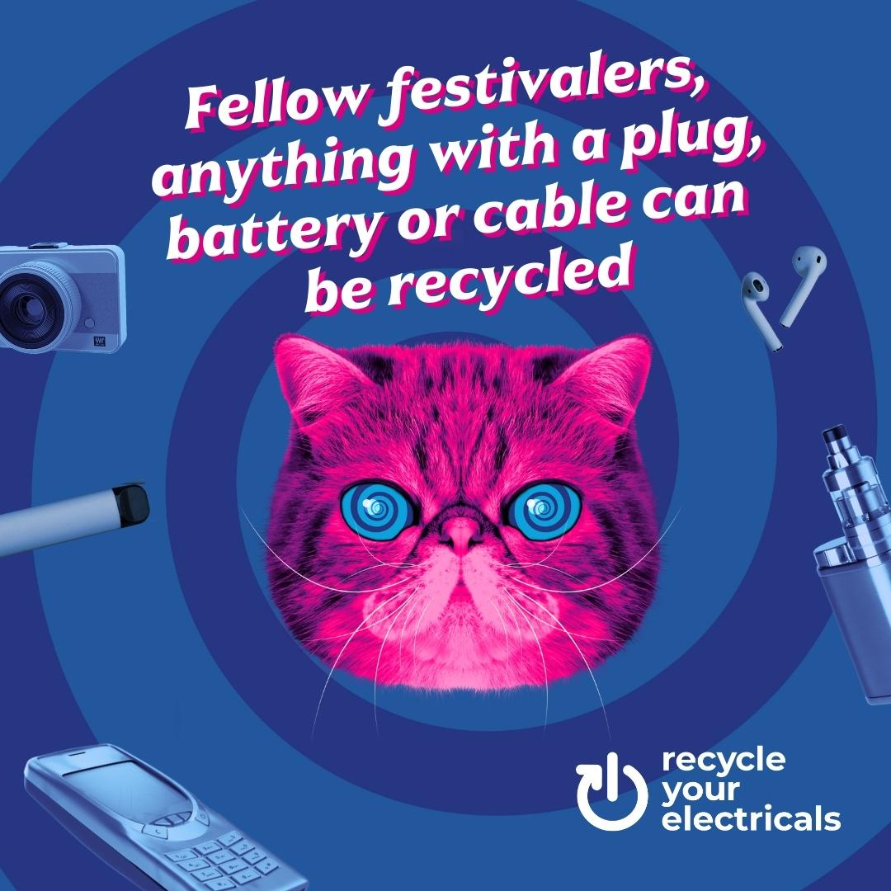
Use HypnoCat to promote electrical recycling (optional)
HypnoCat is our fluffy-faced figurehead, on a mission to purrrsuade the UK to reuse and recycle their electricals.
HypnoCat delivers information in a concise way with a hefty dose of playful and persuasive personality. Using a character allows us to inject masses of personality into what could be a dry topic. Thanks to our nationwide TV campaign, over half of the UK now recognise HypnoCat as the mascot for electrical recycling!
We are happy to work with you to create personalised hypnocat assets like the ones on this slide to suit your needs - get in touch with rowan@materialfocus.org.uk for more information

Slide 34
How to communicate vape recycling to the public
Never bin them - Recycle All Your Vapes
Batteries in vapes can cause fires when binned
Rechargeable vapes
Recycle the battery separately if it is removable
If you can remove the battery, drop it in a battery recycling bin
Put the rest of the vape in a vape recycling bin
If there isn’t a separate bin for vapes, recycle yours with other small electricals
If the battery is not removable, recycle the whole thing with vapes or other small electricals

Slide 35
How to communicate vape recycling to the public
Single-use vapes
Leave the battery inside and recycle the whole thing
Drop the vape in a vape recycling bin
If there isn’t a separate bin for vapes, recycle yours with other small electricals
E-liquid/ vape juice pods
These may contain metals or electrical components
Put pods in the vape recycling bin
If there isn’t a separate bin for vapes, recycle yours with other small electricals

Slide 36
Collecting audience data
Collecting audience data can result in key learnings for future projects and highlight successes. Think about collecting data within your post event audience survey on:
Audience awareness of facilities on site
Did you notice any vape bins onsite?
Did you notice any posters onsite regarding vape recycling?
Audience perception of vapes and e waste
What type of vaping products did you notice at …… festival?
How often do you use vape devices?
How do you dispose of your devices once they have been used?
Are you aware of how to recycle your vapes?
How recycling facilities can be improved in future
What would make it easier/more likely for you to recycle your used vapes?
Did you feel that ….. festival provided adequate information about vaping policies and recycling measures?

Slide 37
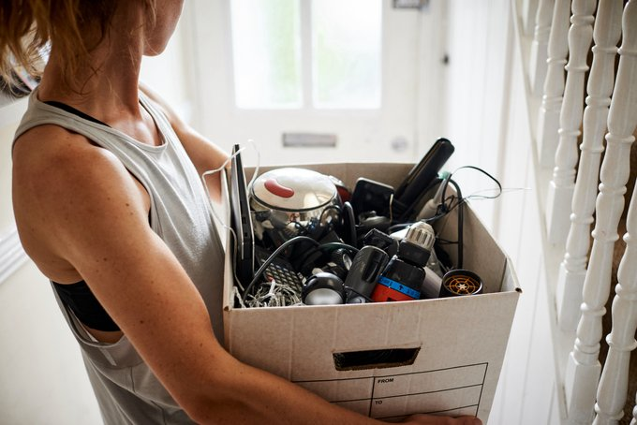
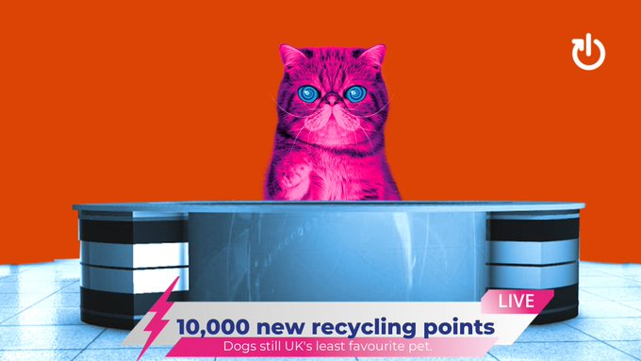
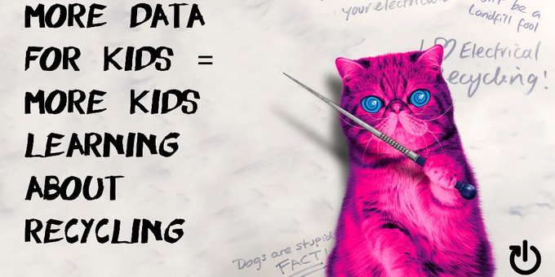
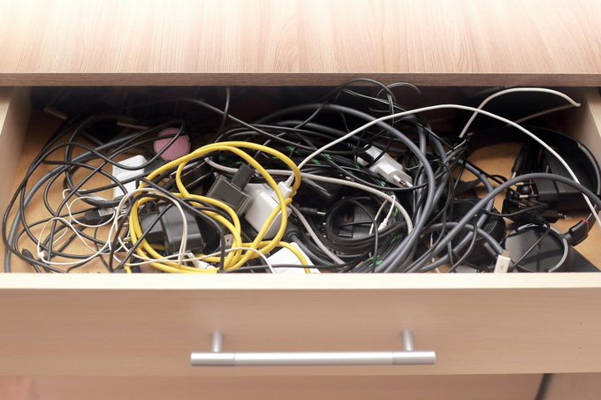
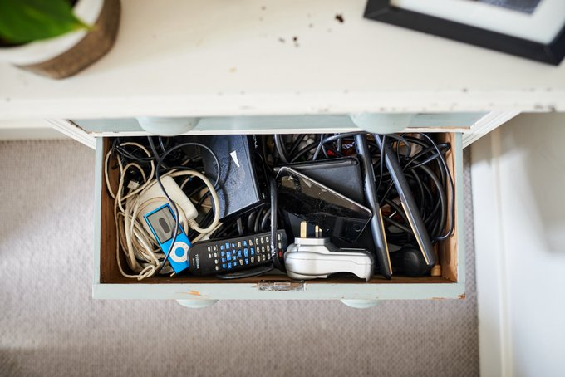
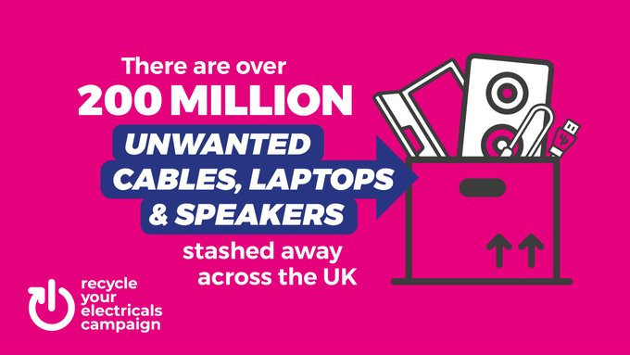
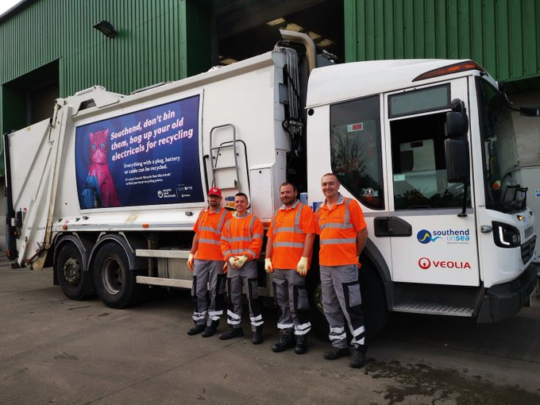
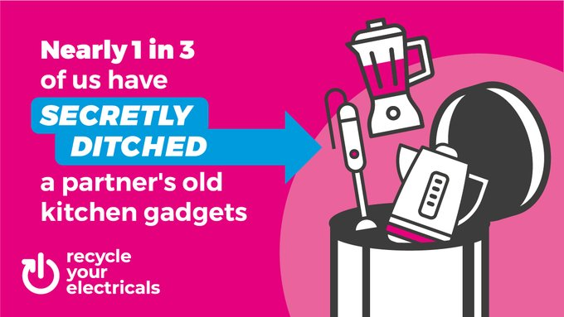
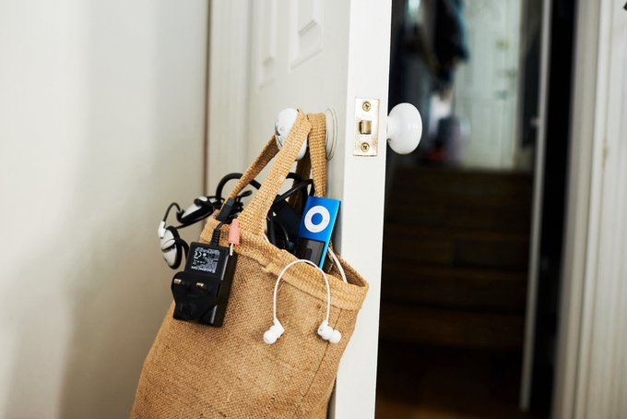
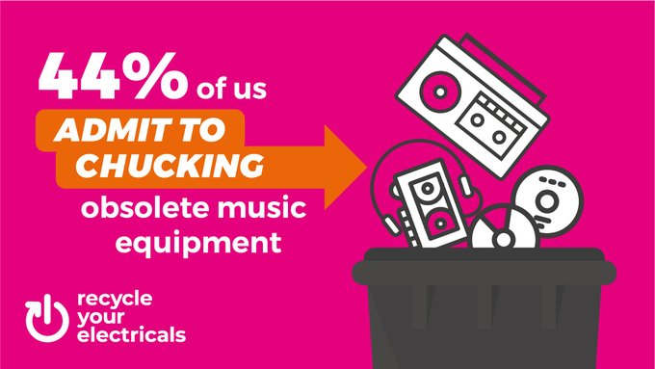
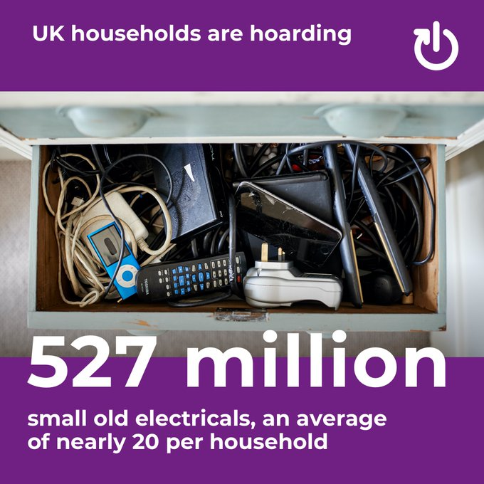
Partner with us

Slide 38
Get in touch
If you would like to discuss creating personalised versions of our communications assets, applying for funding, or just for advice and support, please get in touch with rowan@materialfocus.org.uk to discuss partnership opportunities further.

Slide 39
Contact
The Recycle Your Electricals campaign is led by Material Focus.
Material Focus is a not-for-profit organisation - our vision is of a world where materials are never wasted.
Please follow us and share our content on social media
facebook.com/recycleyourelectricals
www.recycleyourelectricals.org.uk
@recycleelectric
hello@materialfocus.org.uk
@recycleyourelectricals_
linkedin.com/company/materialfocus

